Slide 1
Bank Security
Le Wagon
Tech Talk
Vince King
November 2022

Slide 2
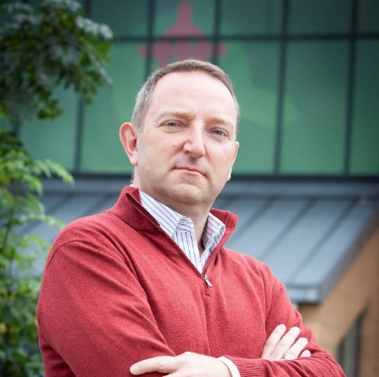








Who’s this talking to me now?
Vincent King
Senior Cyber Analyst
Head of DevSecOps for Cloud Transformation
Bank of England
DevSecOpsVince

Slide 3

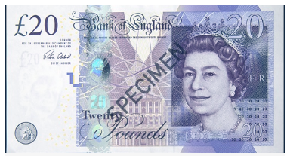
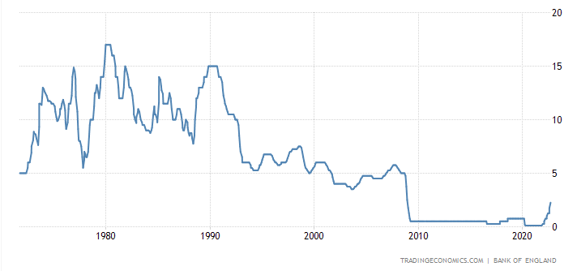
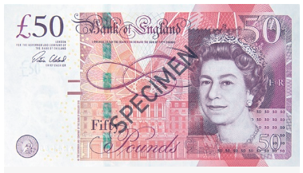
What does the Bank of England do?
Real-Time Gross Settlement
Settled an average of over £720 billion each working day
CHAPS | CREST | BACS | Image Clearing System for cheques | Faster Payments
LINK | Mastercard Europe | Visa Europe | PEXA
RTGS

Slide 4
Questions?
Vincent King
Head of DevSecOps for Cloud Transformation
DevSecOpsVince

Slide 5
DevSecOpsVince

